Slide 2
Digital Logic and Computer Design by
M. Morris Mano
(Chapter 1)
1. Digital Computers and Digital Systems
2. Binary Numbers
3. Numbers Base Conversions
4. Octal and Hexadecimal Numbers
5. Complements
6. Binary (codes, storage, logic, gates)

Slide 3
Digital Logic and Computer Design
Digital Logic subject is concerned with the interconnection among digital components and modules
Digital Logic term used to denote the design and analysis of digital systems
The best known example of a digital system is the general purpose digital computers
Notes:
The complete collection of instructions that are understood by a CPU - Machine Code, Binary,
Usually represented by assembly codes

Slide 4
Computer Functions
All computer functions are:
  Data processing
  Data storage
  Data movement
  Control

Slide 5

A Functional view of the Computer
The computer system must be able to process data, store data and move data b/w itself and the outside world.
A control unit manages the computer’s resources and performance of its functional parts in response to some instructions.
This figure depicts the four possible types of operations.

Slide 6

Operations (1) Data movement
The number of possible operations that can be performed …
(1)
The computer can function as a data movement device, simply transferring data from one peripheral or communication line to another.
  e.g. keyboard to screen

Slide 7
Operations (2) Storage
(2)
The computer can function as a data storage device, with data transferred from the external environment to computer storage for read/write purpose.
  e.g. Internet download to disk

Slide 8
Operation (3) Processing from/to storage
(3)
This diagram show operations involving data processing, on the storage data.
  e.g. updating bank statement

Slide 9
Operation (4)
Processing from storage to I/O
(4)
This diagram show operations involving data processing, on data route b/w storage and the external environment.
  e.g. printing a bank statement

Slide 10
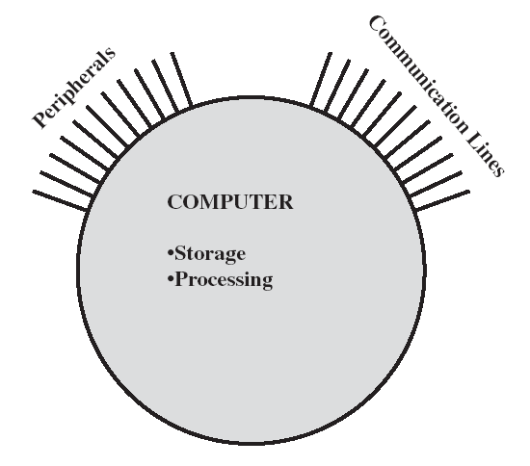
Computer Structure - Top Level
There are four main structural components:
Central Processing Unit (CPU): Controls the operation of the computer and performs its data processing functions; often simply referred to as PROCESSOR
Main Memory: Stores data
I/O: Moves data b/w the computer and its external environment
System Interconnection: Some mechanism that provides for communication among CPU, main memory, and I/O.

Slide 11
Computer Structure - Top Level
Peripherals
Computer
Central
Processing
Unit
Main
Memory
Computer
Systems
Interconnection
Input
Output
Communication
lines

Slide 12
Structure - The CPU
Control Unit: Controls the operations of the CPU and hence the computer
ALU: Performs the computer’s data processing functions
Registers: Provides storage internal to the CPU
CPU
Computer
Arithmetic
and
Login Unit
I/O
Registers
System
Bus
CPU
Internal CPU
Interconnection
Memory
Control
Unit
CPU Interconnection: Some
mechanism that provides for communication
among the control unit, ALU, and registers

Slide 13
Structure - The Control Unit
Control Unit
CPU
ALU
Sequencing
Login
Internal
Bus
Control
Unit
Control Unit
Registers and
Decoders
Registers
Control
Memory

Slide 14
Program Concept
Hardwired Program- process of connecting various components in desired conf. as a form of programming, the resulting ‘program’ is in form of hardware, is called a hardwired program- systems are inflexible. The system accepts data and produces results.
General purpose hardware- system accepts data and control signals and produces results (instead of re-wiring hardware for each new program, supply a new set of
control signals), this new method of
programming, a sequence of codes or
instruction is called software.
What is a program?
A sequence of steps
For each step, an arithmetic or
logical operation is done
For each operation, a different set of
control signals is needed
Sequence of arithmetic and logic functions
Data
Results
(a) Programming in hardware
Instruction interpreter
Instruction codes
Control signals
Sequence of arithmetic and logic functions
Data
Results
(b) Programming in software

Slide 15
Levels of Representation
High Level Language Program
temp = v[k];
v[k] = v[k+1];
v[k+1] = temp;
Compiler
mov ax, bx
add bx, cx
int al, 21
sw $15, 4($2)
Assembly Language Program
Assembler
0000 1001 1100 0110 1010 1111 0101 1000
1010 1111 0101 1000 0000 1001 1100 0110
1100 0110 1010 1111 0101 1000 0000 1001
0101 1000 0000 1001 1100 0110 1010 1111
Machine Language Program
Machine Interpretation
Control Signal Specification
ALUOP[0:3] <= InstReg[9:11] & MASK
°
°

Slide 16
Computer Components
The Control Unit and the Arithmetic and Logic Unit constitute the
  Central Processing Unit
Data and instructions need to get into the system and results out
  Input/output
Temporary storage of code and results, is needed
  Main memory

Slide 17
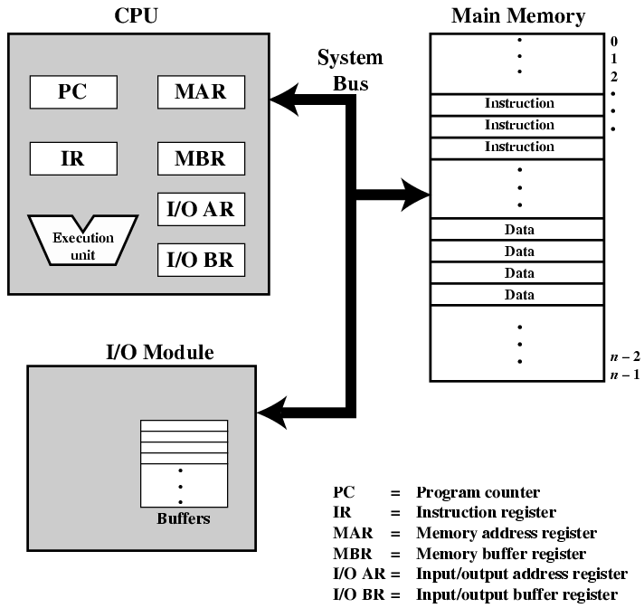
Computer Components:
Top Level View

